Slide 1

Feature Selection Evaluation
Joe Xu and Ziyang Tian

Slide 2
Goal of Feature Selection
Save time & money in daily lookalike modeling tasks
Achieve similar performance to models using full features

Slide 3
Previous work
Use mutual information to calculate the weight of each feature
Select features with ”high” weights
Problem
Difficult to set a cut-off point
Difficult to programmatically select important features
Solution:
Define metrics to quantify the performance of feature selection.
Compare performance between models with full & selected features

Slide 4

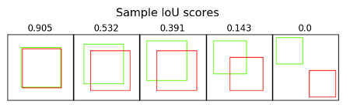
Feature Selection Performance Metrics
Distance from Cluster Center (Unbounded): Distance from a pool user to its nearest segment user cluster center.
Similarity Scores (0 – 100): Calculated from the distribution of the Distance from Cluster Center. Represents how much a pool user looks like a segment user, with 100 showing the max confidence and 0 showing the least.
Intersection over Union (IoU) (0 – 1): Represents how much overlap it will when we pick a certain number of top lookalikes, with 1 showing we are picking the exact same group of users and 0 showing all different.

Slide 5
Feature Selection Evaluation Method
For each segment, run lookalike models with different feature numbers (selected using weight from high to low).
Pick top 1k, 10k and 100k lookalikes from each result and calculate IoU.
Use similarity scores and distance from cluster centers as references.

Slide 6
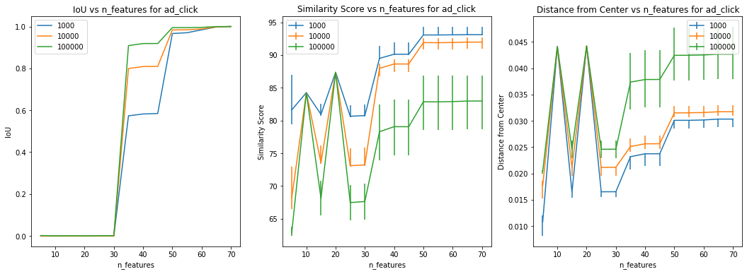
Segment: AD Clicker (794,628 users)
Recommended feature number: >= 35
Notes:
Recommended feature number: >= 35

Slide 7
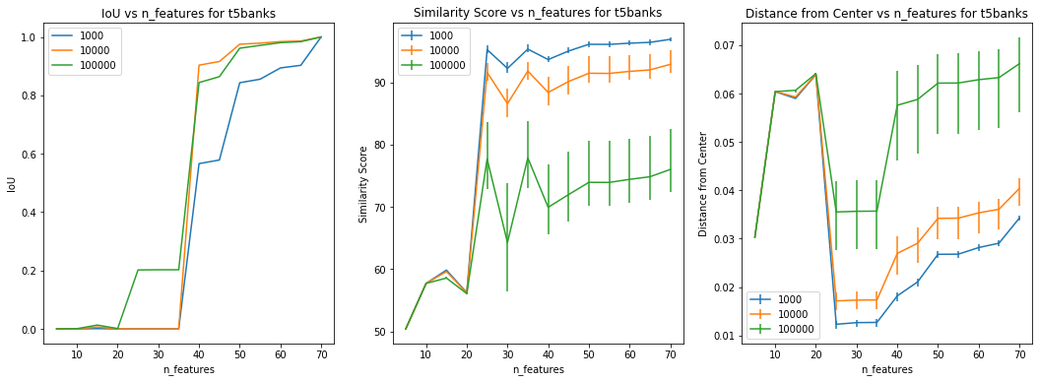
Segment: Users who do site search for stock tickers of top 5 banks (38,797 users)
Recommended feature number: >= 40
Notes:
Recommended feature number: >= 40

Slide 8
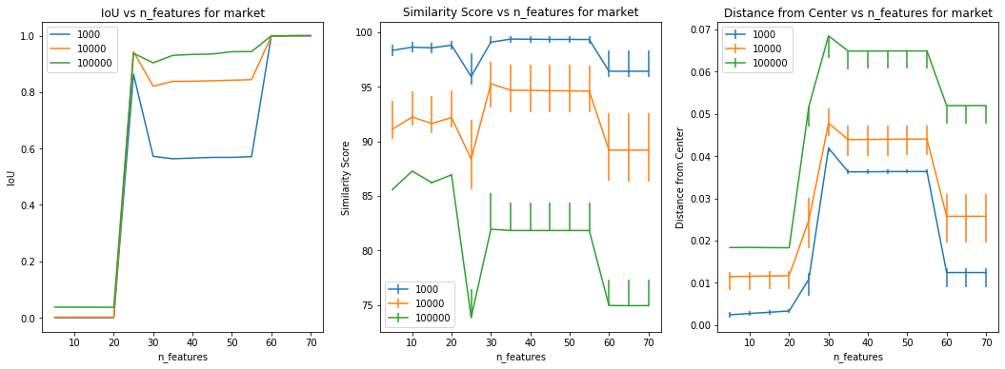
Segment: Market (254,853 users)
Recommended feature number: >= 25
Notes:
Recommended feature number: >= 25

Slide 9
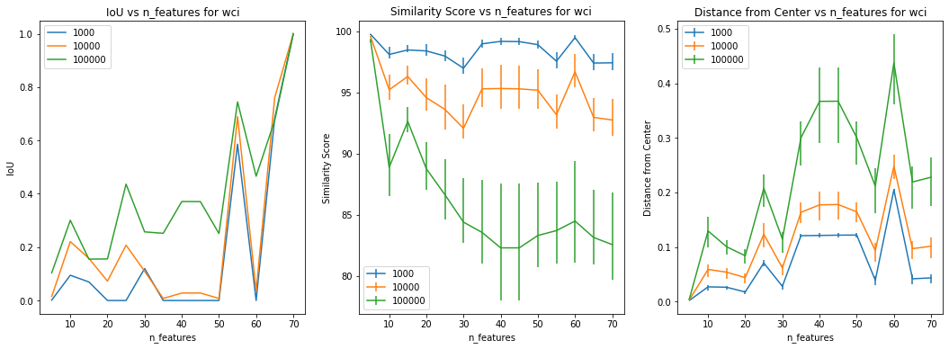
Segment: Globe Readers - White Collar Industries (9,404 users)
Recommended to use all features
Notes:
Recommended to use all features

Slide 10
Next Steps
Keep track of individual segments over time and see if the essential features are consistent.
Work on the methods of dynamically selecting feature size:
1st order: Set up a threshold (eg. IoU > 0.5)
2nd order: Change rate of metrics (eg. IoU_2 – IoU_1 > 0.3)
...
Questions:
When selecting lookalike users from pool, do you prefer:
Select based on similarity score (eg. Score > 80)
Select based on a certain number (eg. 10,000 users)
Select based on a ratio (eg. 10% of segment users)

Slide 11
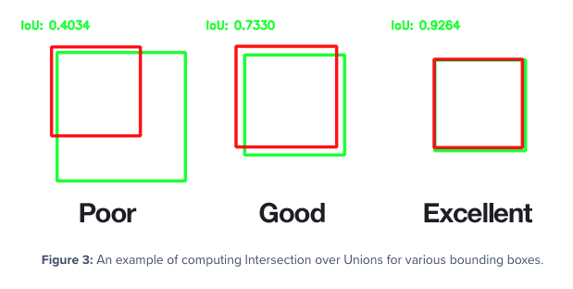
Appendix

